Slide 1

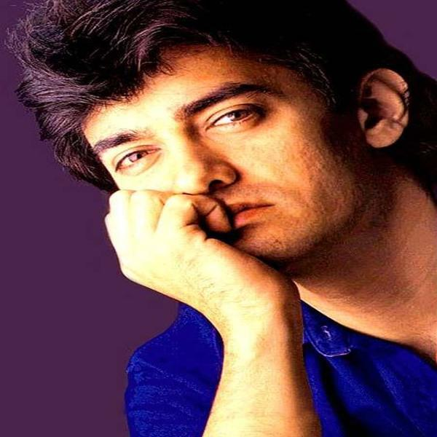
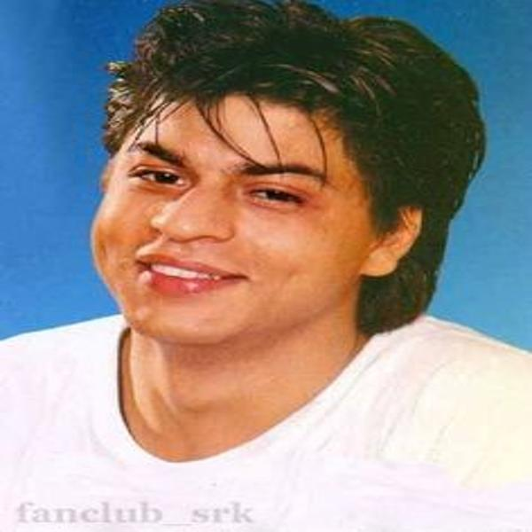
ACTORS CLASSFIFCATION

Slide 2
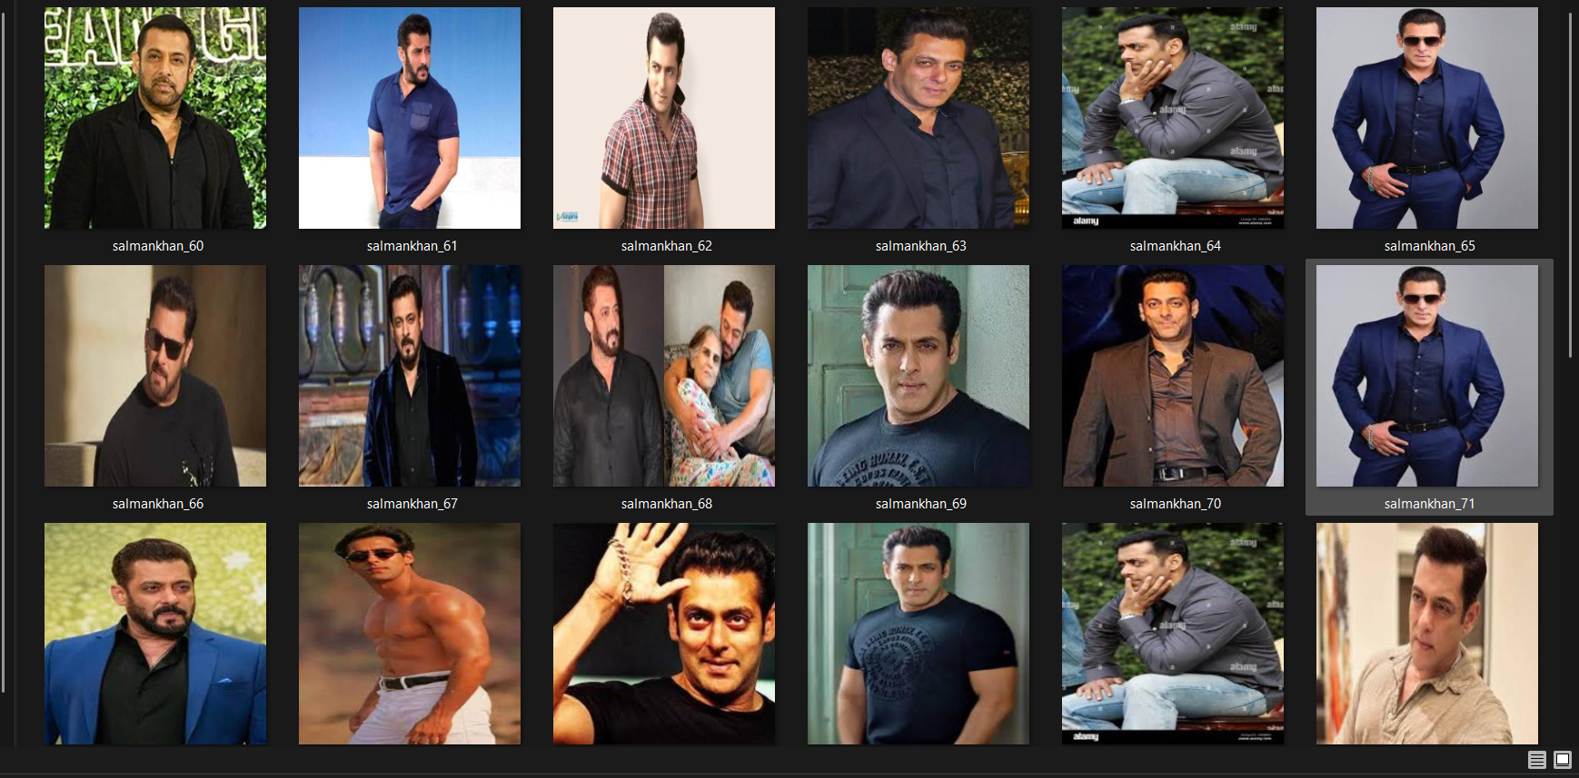
DOWNLOAD IMAGES

Slide 3
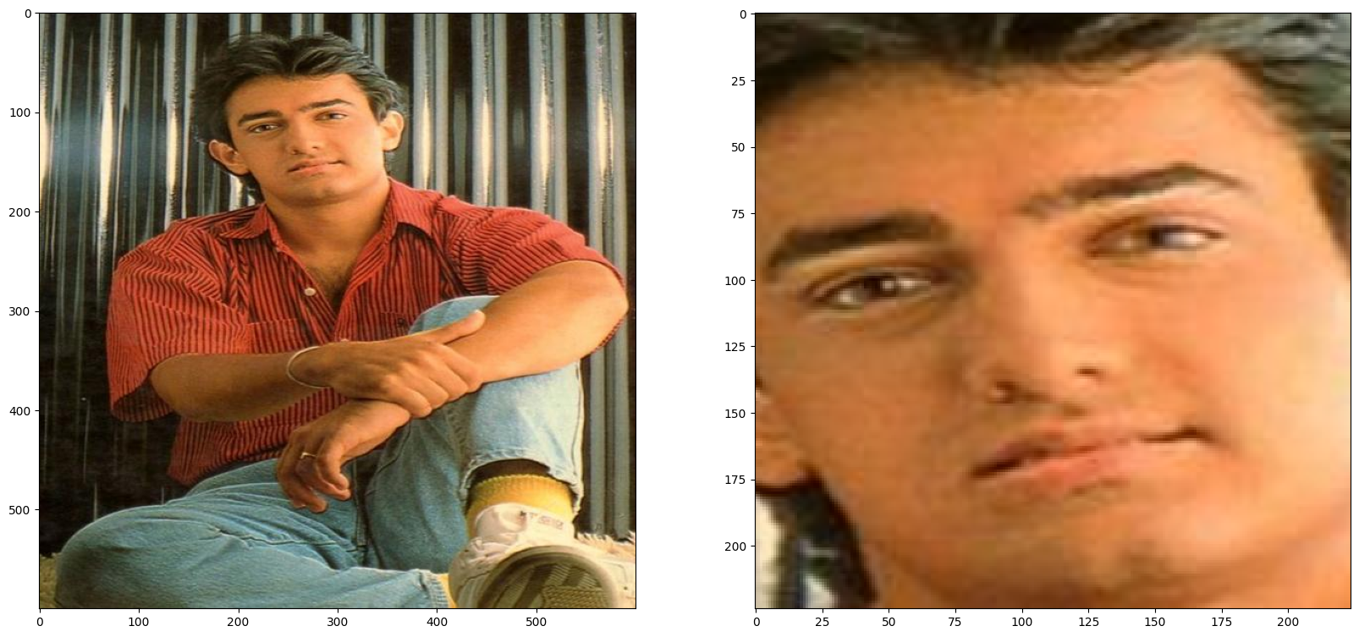
FACE DETECTION

Slide 4
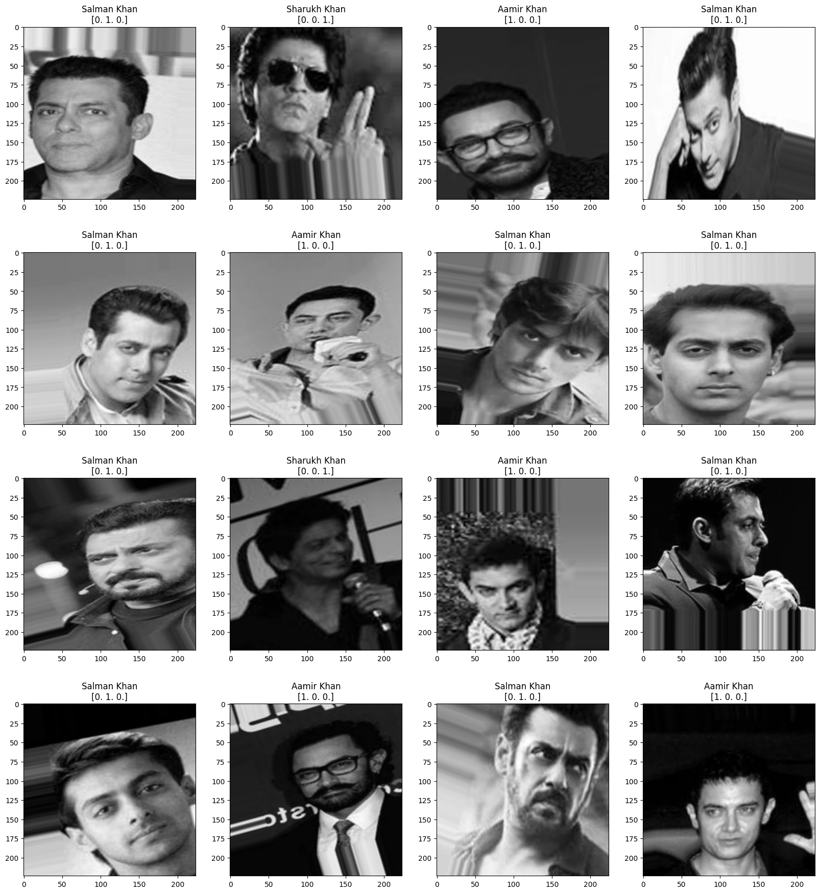
GRAYSCALE IMAGE

Slide 5
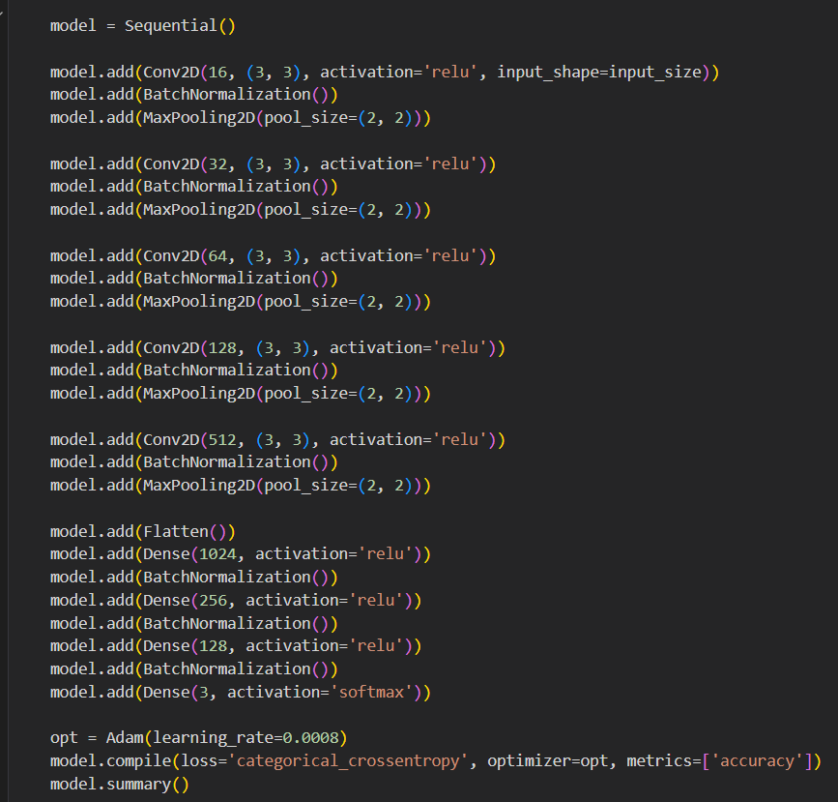
TENSORFLOW CNN MODEL

Slide 6
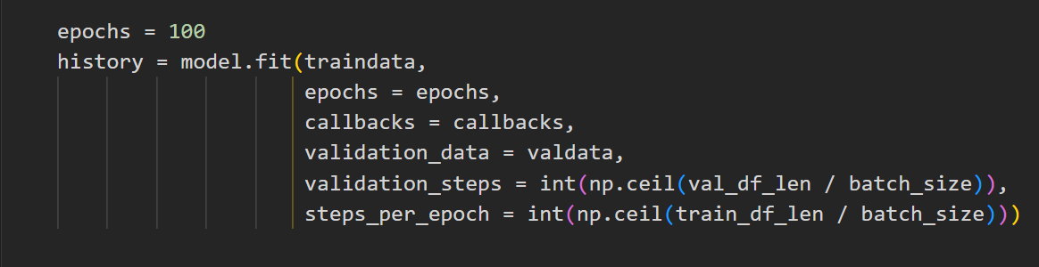
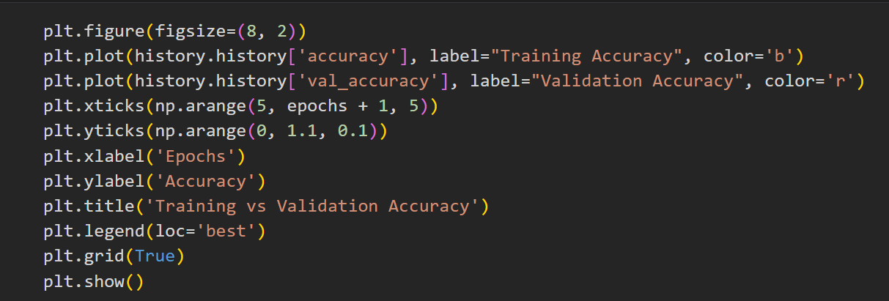
LINE BY LINE EXPLANATION

